Slide 1
INTRODUCTION TO PHYSIOLOGY
Dr. Tabish Masood Ranjha

Slide 2
What is Physiology?
Physiology is the science of studying the functional activities and its mechanisms in biological body.
For example: why can heart automatically beat?
Physiology derived from two Greek words – physis = nature;
logos = study

Slide 3
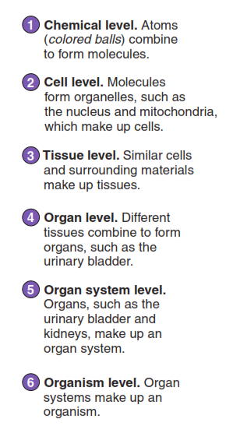
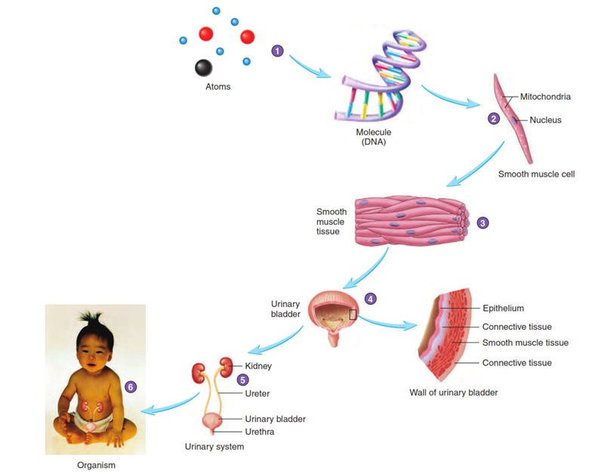
Levels of Structural Organization

Slide 4
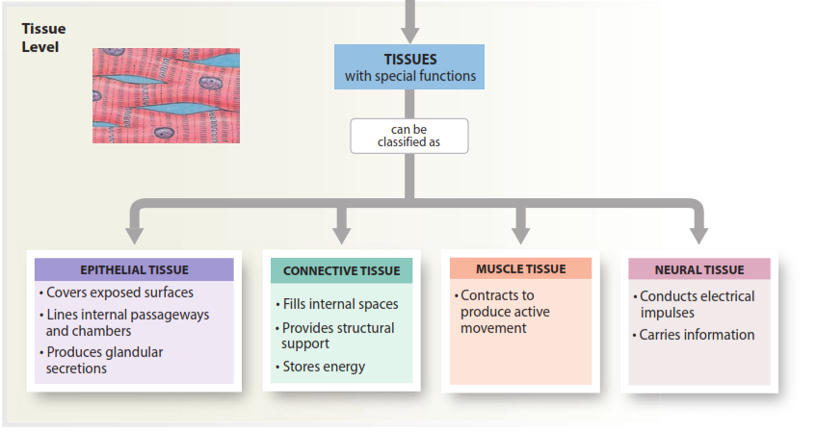
Levels of Structural Organization

Slide 5
Key Themes in Physiology:
Homeostasis
Body systems work together (Integration of function)
Internal vs. external failure of homeostasis
2. Communication and movement across cell membranes
Vital to integration & homeostasis
Cells communicate with other cells, tissues & organs

Slide 6
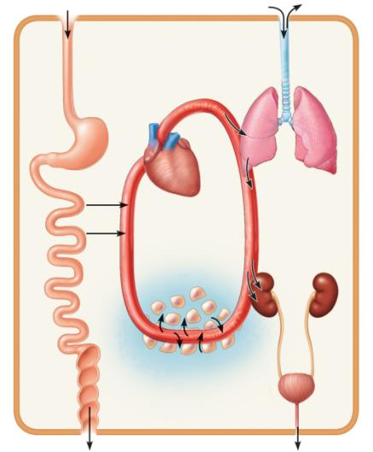
All cells depend on organ systems to meet their survival needs. Organ systems work cooperatively to perform necessary life functions
Organ Systems Interrelationships
Digestive system
Takes in nutrients, breaks them
down, and eliminates unabsorbed
matter (feces)
Respiratory system
Takes in oxygen and
eliminates carbon dioxide
Food
O₂
CO₂
Cardiovascular system
Via the blood, distributes oxygen
and nutrients to all body cells and
delivers wastes and carbon
dioxide to disposal organs
Blood
CO₂
O₂
Urinary
system
Eliminates
nitrogenous
wastes and
excess ions
Heart
Nutrients
Interstitial fluid
Nutrients and wastes pass
between blood and cells
via the interstitial fluid
Integumentary system
Protects the body as a whole
from the external environment
Feces
Urine

Slide 7
Body Fluids
Body composition
In average young adult male:
% of body weight | Body composition
18% | Protein, & related substances
15% | Fat
7% | Mineral
60% | Water

Slide 8
Body Fluids
1. Extracellular fluid (ECF):
(internal environment or the milieu intérieur)
- fluid outside the cells.
≈ 1/3 volume of fluids in body (≈ 33% of total body water).
- contains ions & nutrients needed for cellular life.
Extracellular fluid is further divided into
A. Interstitial Fluid: Fluid between the cells
B. Plasma: Fluid portion of blood
2. Intracellular fluid (ICF):
- fluid inside the cells.
≈ 2/3 volume of fluids in body (≈ 67% of total body water).

Slide 9
Fluid Compartments ≈ 60% of body weight
Fluid Compartments
Extracellular fluid
(≈ 1/3)
33% of TBW
20% of body wt
Intracellular fluid
(≈ 2/3)
67% of TBW
40% of body wt
Plasma
25% of ECF
5% of body wt
Interstitial fluid
75% of ECF
15% of body wt
Transcellular fluid
CSF
Intraocular
Pleural
Peritoneal
Pericardial
Synovial
Digestive secretions

Slide 10
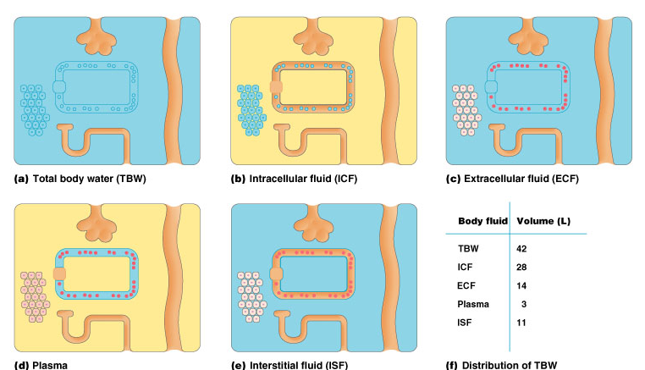
Body Fluid Compartments

Slide 11
Example: How to calculate total body water (TBW)?
Q. Calculate TBW for a 70 kg man.
TBW = 60% of body weight
TBW = 60% X 70 = 42 L of water
28 liters intracellular fluid (ICF) – (2/3rd)
14 liters extracellular fluid (ECF)- (1/3rd)
-3 liters plasma
-11 liters interstitial fluid (ISF)

Slide 12
Differences between ECF & ICF
ECF
Anions: Cl⁻ (108) HCO₃⁻ (24) | Cations: Na⁺ (142mmol/L) K⁺ (4.2) Mg²⁺ (0.8)
Nutrients: O₂, glucose, fatty acids, & amino acids.
Wastes: CO₂, Urea, uric acid, excess water, & ions.
ICF
Anions: Cl⁻ (4) HCO₃⁻ (10) Phosphate ions | Cations: Na⁺ (14) K⁺ (140) Mg²⁺ (20)
Nutrients: High concentrations of proteins.

Slide 13
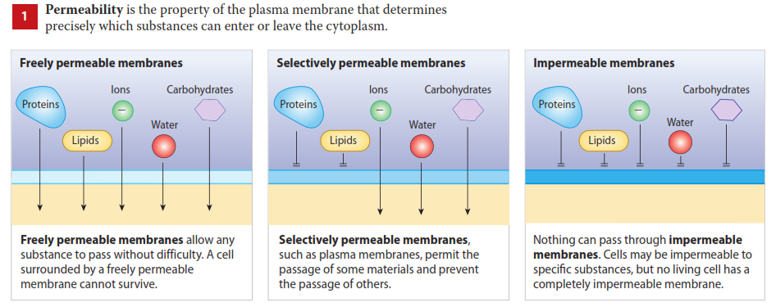
How Substances Enter and Leave the Cell

Slide 14
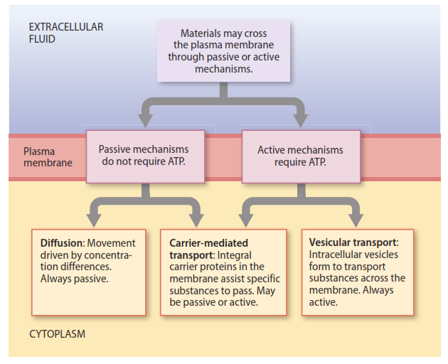
How Substances Enter and Leave the Cell

Slide 15
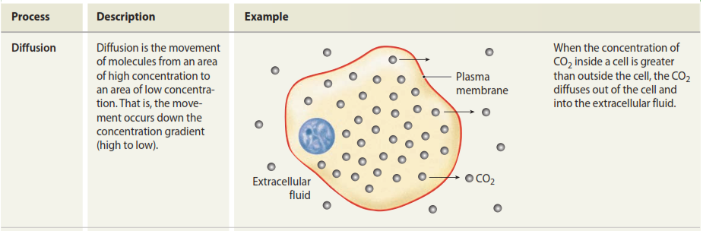
Passive Transport Processes (No cellular energy expended)
Passive transport: Don’t use carrier protein

Slide 16
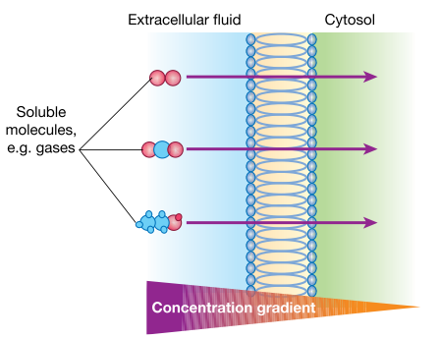
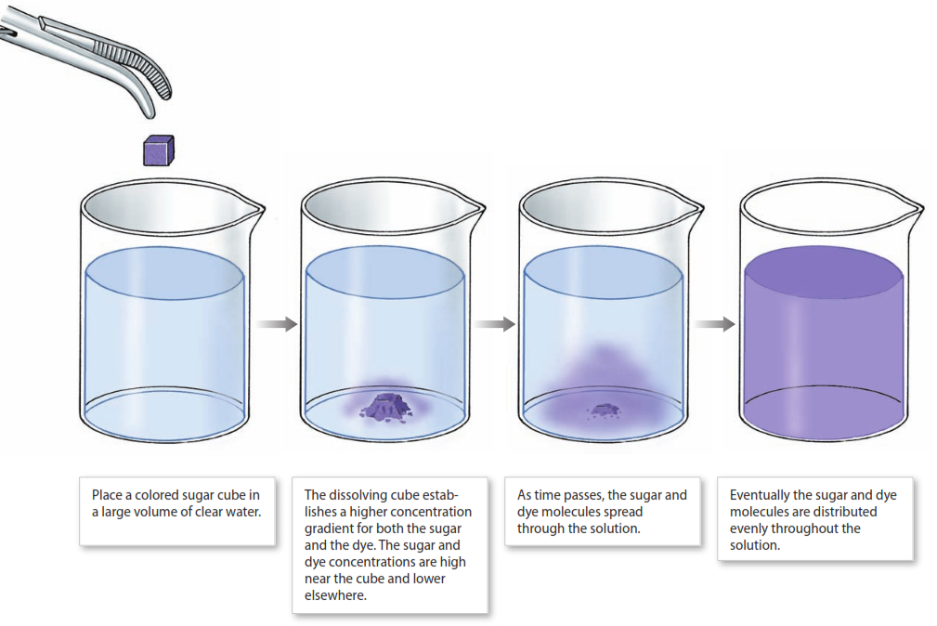
Diﬀusion is movement driven by concentration diﬀerences

Slide 17
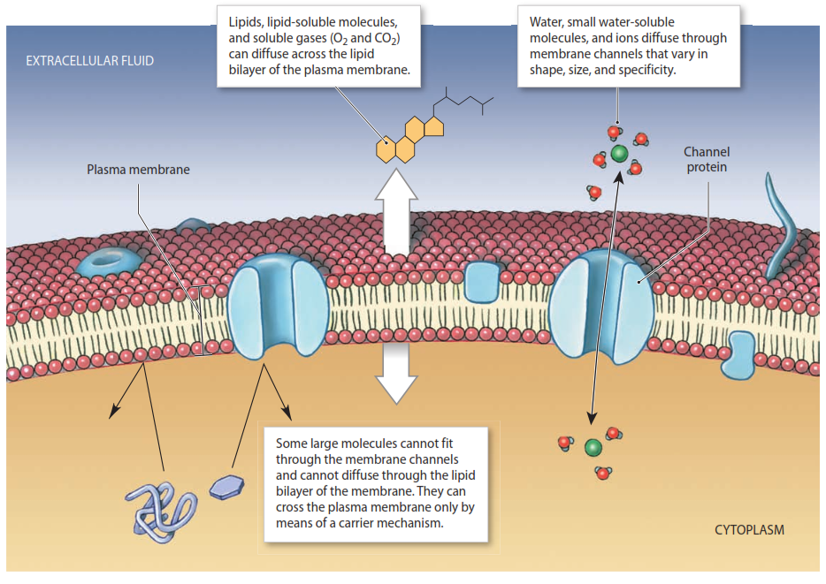
Diﬀusion is movement driven by concentration diﬀerences

Slide 18
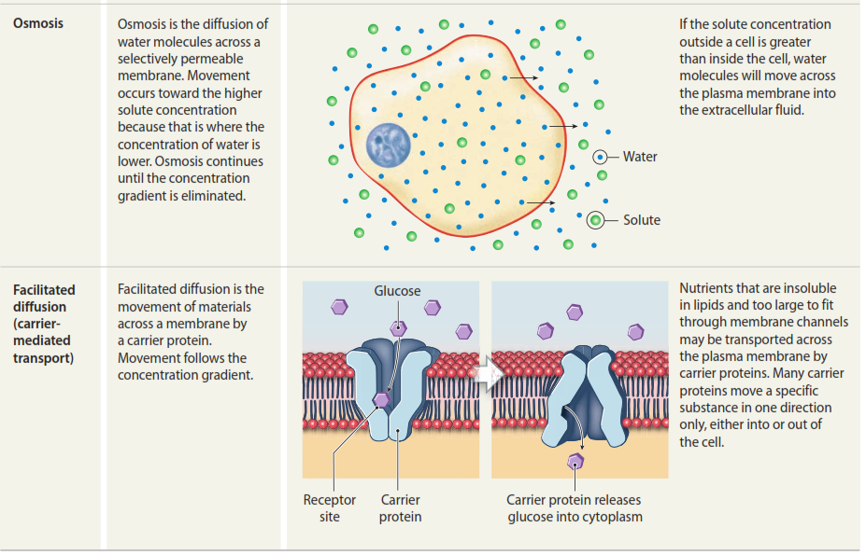
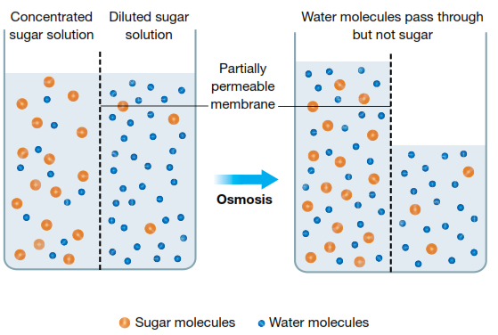
Passive Transport Processes
(No cellular energy expended)
Osmosis: Passive transport: Don’t use carrier protein

Slide 19
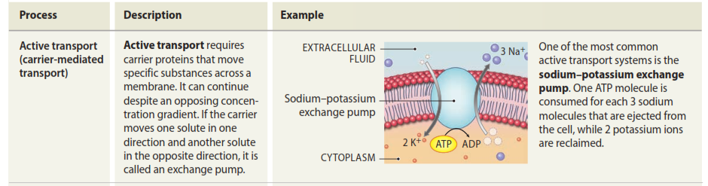
Active Transport Processes
(Require ATP or other energy sources)
Active transport: Use carrier protein
Na+ K- pumps 3 Na+ out and 2K+ inside the cell

Slide 20
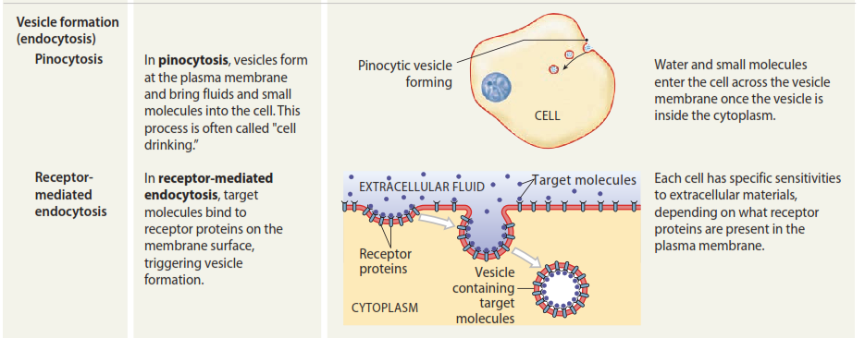
Active Transport Processes
(Require ATP or other energy sources)

Slide 21
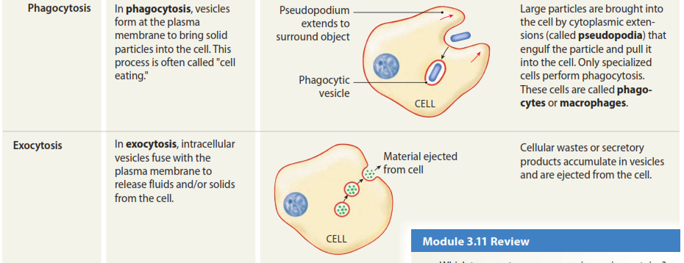

Active Transport Processes
(Require ATP or other energy sources)
Form vesicle

Slide 22
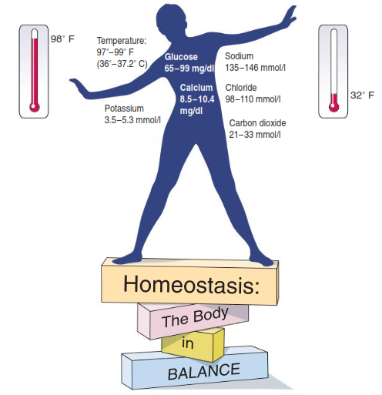
HOMEOSTASIS
Homeostasis homeo-, the same) is the existence and maintenance of a relatively constant environment within the body despite fluctuations in either the external environment or the internal environment.
Walter Cannon coined the term "homeostasis" (1929)

Slide 23
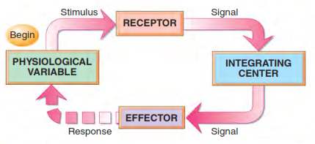
Homeostatic Regulation
This process of adjustment (called homeostatic regulation) involves:
a receptor (which receives information about a change in the environment),
a control center (which receives and processes information from the receptor), and
an effector (which responds to signals from the control center by either opposing or enhancing the stimulus).
Receptor
Afferent Pathway
Integrating or control center
Efferent Pathway
Effector

Slide 24
FEEDBACK
The signal sent by the effector is called feedback; feedback can be either negative or positive.
Negative feedback: when the effector opposes the stimulus (such as a dropping temperature) and reverses the direction of change (causing the temperature to rise).
Example: Decrease in Blood Glucose and Blood pressure

Slide 25
Positive feedback:
When the effector reinforces the stimulus (such as uterine contractions during childbirth, which trigger the release of the hormone oxytocin) and amplifies the direction of change (causing even greater contractions and further release of oxytocin).
Example: Blood clotting, protein digestion, a temperature of 100.2F causes further increase

Slide 26
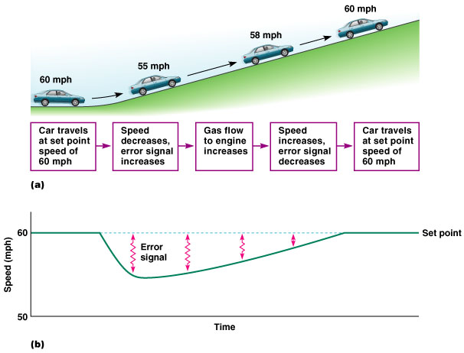
Negative Feedback Control of Car Speed

Slide 27
Negative Feedback – Temp Regulation
Response to Heat Stress
Thermoreceptors in skin detect a rise in body temperature
Nervous system in brain sends message to hypothalamus
Hypothalamus response:
Sweating: Sweat glands to initiate sweating – evaporation of sweat cools body
Vasodilation: Blood vessels to dilate – more blood glows to skin, which has been cooled by evaporation

Slide 28
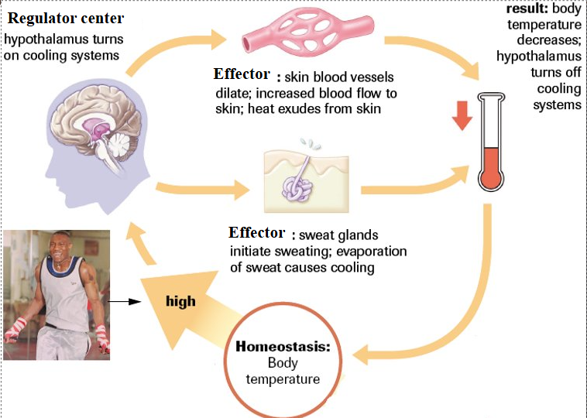
Negative Feedback – Temp Regulation

Slide 29
Negative Feedback – Temp Regulation
Thermoreceptors in the skin send a message to the hypothalamus
Hypothalamus response:
Vasoconstriction: Constricts smooth muscle of arterioles – blood flow is limited, heat loss from skin is reduced
Piloerection: Constricts smooth muscle around hair follicles, causing hair to stand on end – erect hair traps warm air next to skin
Shivering : Skeletal muscles to initiate rhythmic contractions (10 – 20x per minute)

Slide 30
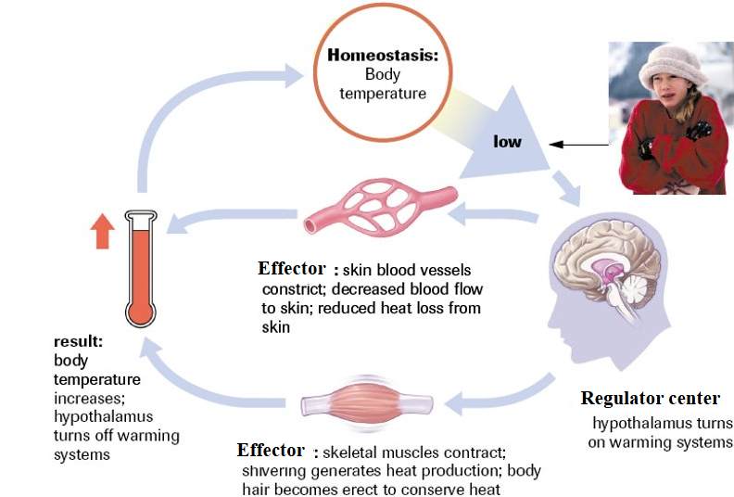
Negative Feedback – Temp Regulation

Slide 31
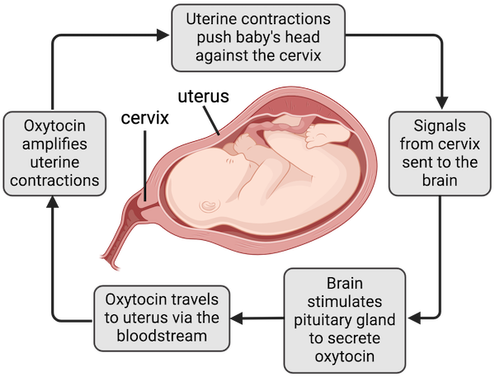
Positive Feedback during childbirth

